Slide 1

Nashville City Cemetery
Mariah Norman

Slide 2
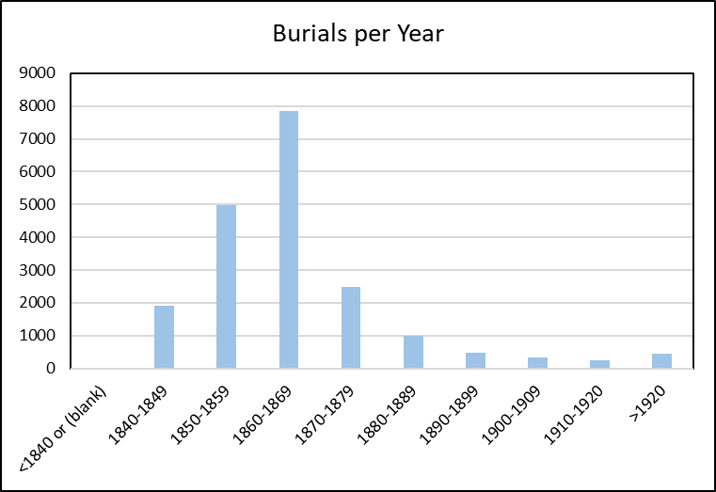

Slide 3
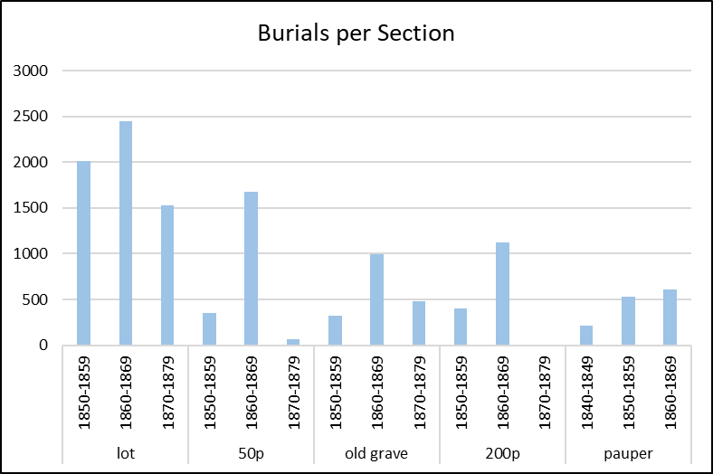
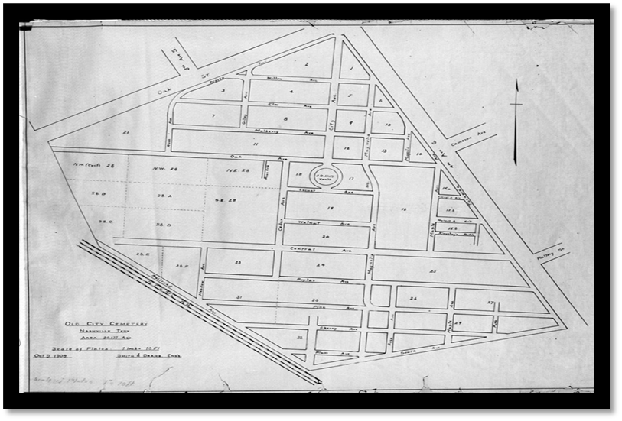


Slide 4
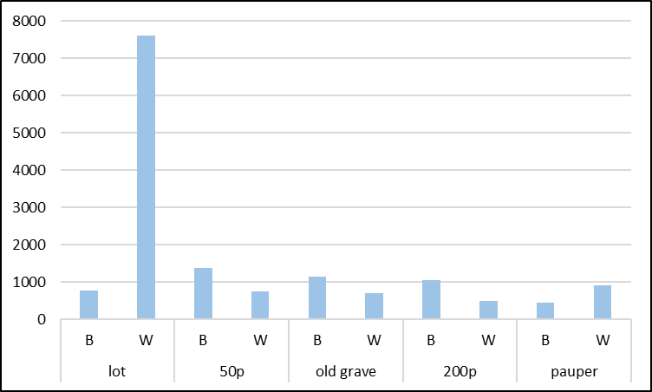
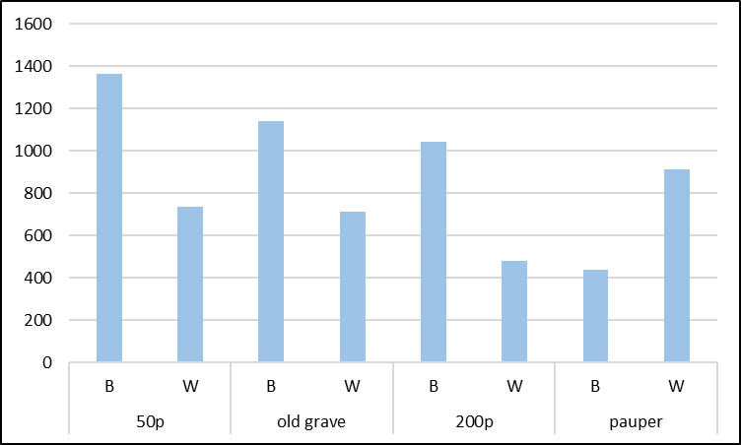
Burials per Section B: Black W: White

Slide 5
Sources
http://www.thenashvillecitycemetery.org/index-2.html

